Slide 1
Unit III Engineering Materials
Topic: Polymer composite – Glass and carbon reinforced plastics
Dr. P. G. Umape
Department of Applied Science
Pune Institute of Computer Technology

Slide 2
Learning outcomes
Students will be able to
Define composite material
classify composite material
Discuss composition and properties of Glass and carbon reinforced plastics.
Discuss application of Glass and carbon reinforced plastics.

Slide 3
Polymer Composites
Polymer is a versatile material and due to its appreciable physical properties, molding ability it has ability to substitute classical engineering materials.
But its mechanical properties and dimensional strength has to be increased for its efficient use as an engineering material.
It can be achieved by addition of some external materials with the polymer.

Slide 4
Polymer Composites
Here polymer used is called as matrix phase or substrate.
While the external material added in polymer is called as reinforced material or dispersed phase.
A polymer composite is a mixture of polymer matrix with reinforced material with distinct phases resulting a symbiotic properties that are higher than either component alone.

Slide 5
Polymer Composites
Polymer composite:
Objective of adding polymer:
To bind the reinforcing particles or fibres strongly.
Acts as a medium for distribution of applied load.
Keeps proper orientation of reinforcing fibres for high strength development.
To prevent cracks propagation due to plasticity.

Slide 6
Polymer Composites
Condition:
The Matrix phase and reinforced phase must have good compatibility with each other.
There should be strong bond formation between 2 phases after composite formation.

Slide 7
Polymer Composites
Types of Composite material: Based on matrix
1. Metal matrix composite
Metals like aluminum, magnesium, copper used as matrix while ceramic or metallic materials are used as reinforcing agent.
2. Ceramic matrix composite
Ceramic matrix dispersed by metal or ceramic reinforcing agent.
3. Polymer matrix composite
Here matrix used is polymer, may be thermosetting or thermosoftening polymer.

Slide 8
Polymer Composites
Types of Composite material:
Based on reinforcing agent
Particles Reinforced composite
here the reinforced material is particles of metal or ceramic materials in the form of flakes.
Structural Composites
Here composite material is formed by several layers of reinforced materials.

Slide 9
Polymer Composites
Based on reinforcing agent
Structural Composites
Laminar – Sheets or panels with proper orientation & cemented together with resin. E. g. Plywood
Sandwiched – 2 strong outer sheets separated by a layer of less dense material (core)
Fiber Reinforced composite
Fibers of glass, polymer fibers, carbon fibers are used as reinforcing agent.

Slide 10
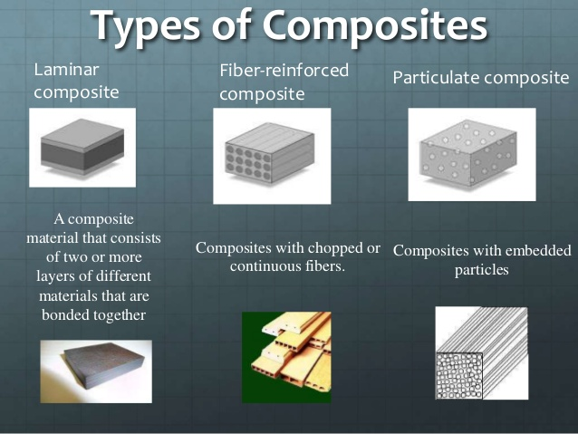

Slide 11
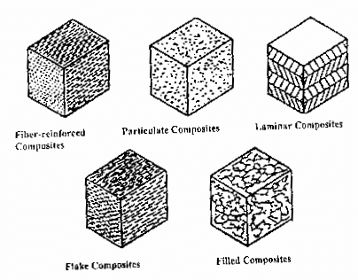

Slide 12
Glass reinforced Plastics
Composition:
Polymer matrix reinforced by glass fiber
Properties:
High corrosion resistance
High strength
Light weight
Non conductive, non sparking and inert
High impact resistance
Easy to fabricate
Low maintenance

Slide 13
Glass reinforced Plastics
Applications
Aircraft, boats
high performance cars
bath tubs
swimming pools
hot tubs
septic tanks
water tanks
roofing, pipes
Surfboards
door skins

Slide 14
carbon reinforced Plastics
Composition:
Polymers like epoxy resin, polyester, vinylester or nylon reinforced by carbon material like aramid (kevlar), high molecular weight PE
Properties:
High strength and rigidity
Light weight
It is conductive in nature
High tensile strength

Slide 15
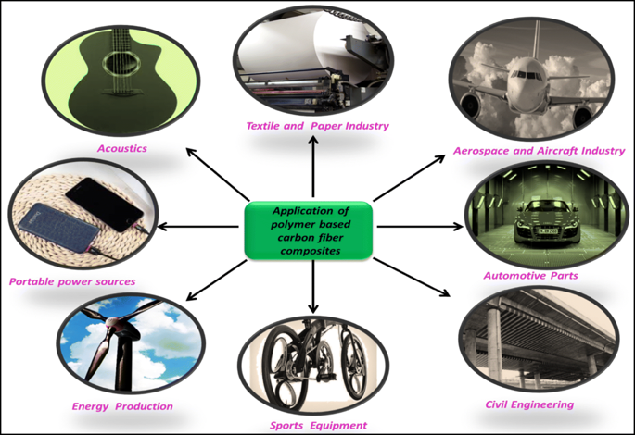
carbon reinforced Plastics
Applications :
Aerospace ,
Sail boats,
Modern bicycles
motor cycles,
Laptops,
Tripods,
fishing rods,
Racquet frames,
stringed instrument bodies
golf clubs

Slide 16
summary
Definition of composite materials
Types of composite materials
Composition of Glass and carbon reinforced plastics
Properties and applications of Glass and carbon reinforced plastics

